Slide 1
February 2025 Battery FIAMM – Riyadh L3
ALSTOM RS
2025-02-18
Caio Oliveira

Slide 2
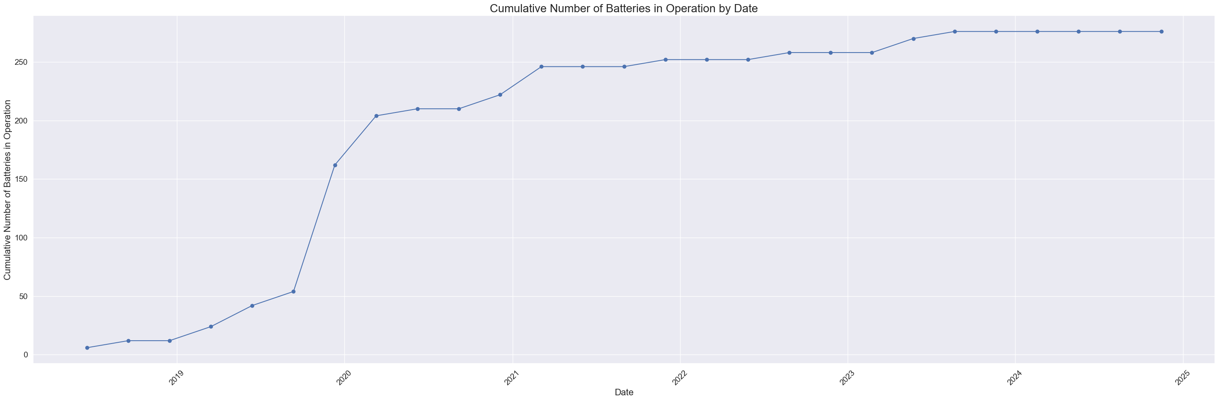
Summary
Total of 276 batteries in operation
Total time of 11,825,568 hours
Data up to 02/02/25

Slide 3
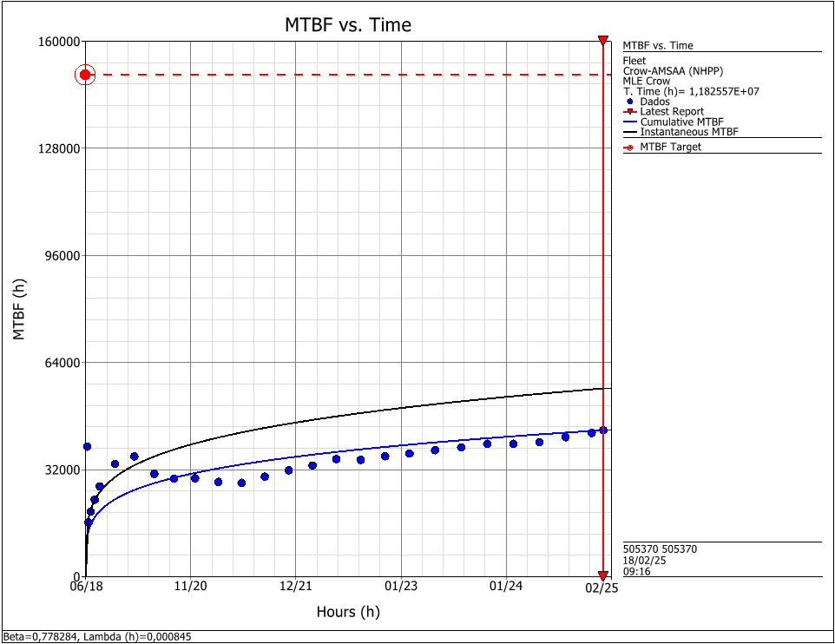
MTBF
As the main parameter for the reliability growth analysis is lowering over time, that means that the reliability is increasing at a faster rate over time
Oct/24 – β = 0,793
Dec/25 – β = 0,784
Feb/25 – β = 0,778

Slide 4
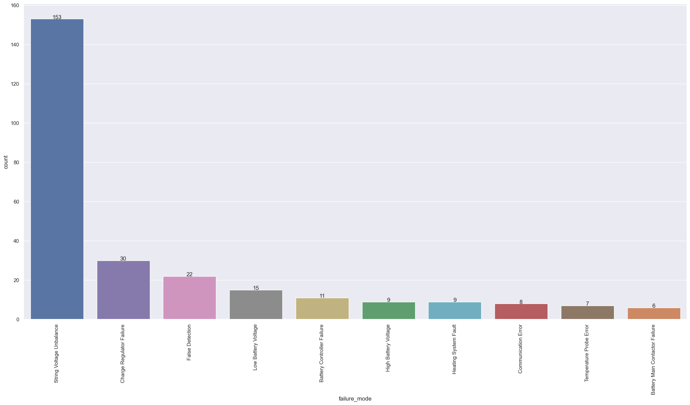
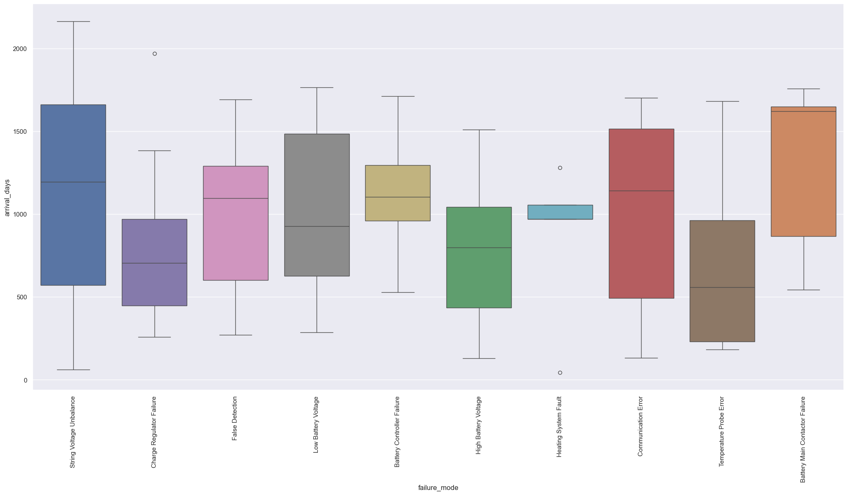
Failure Modes
Most relevant failure modes
String Voltage Unbalance
Charge Regulator Failure
False Detection
Low Battery Voltage

Slide 5
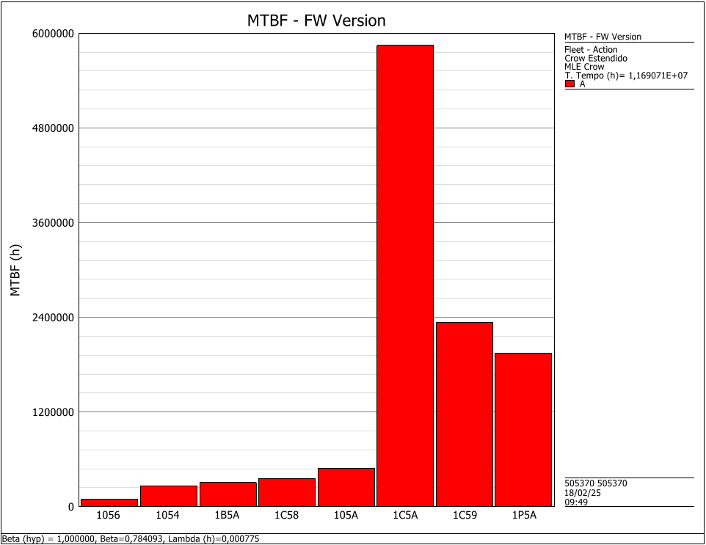
MTBF – FW Version
1056 – 99,921 hours
1056 – 259,974 hours
1B5A – 307,650 hours
1C58 – 354,264 hours
105A – 487,113 hours
1C5A – 5,845,356 hours
1C59 – 2,338,142 hours
1P5A – 1,948,452 hours

Slide 6
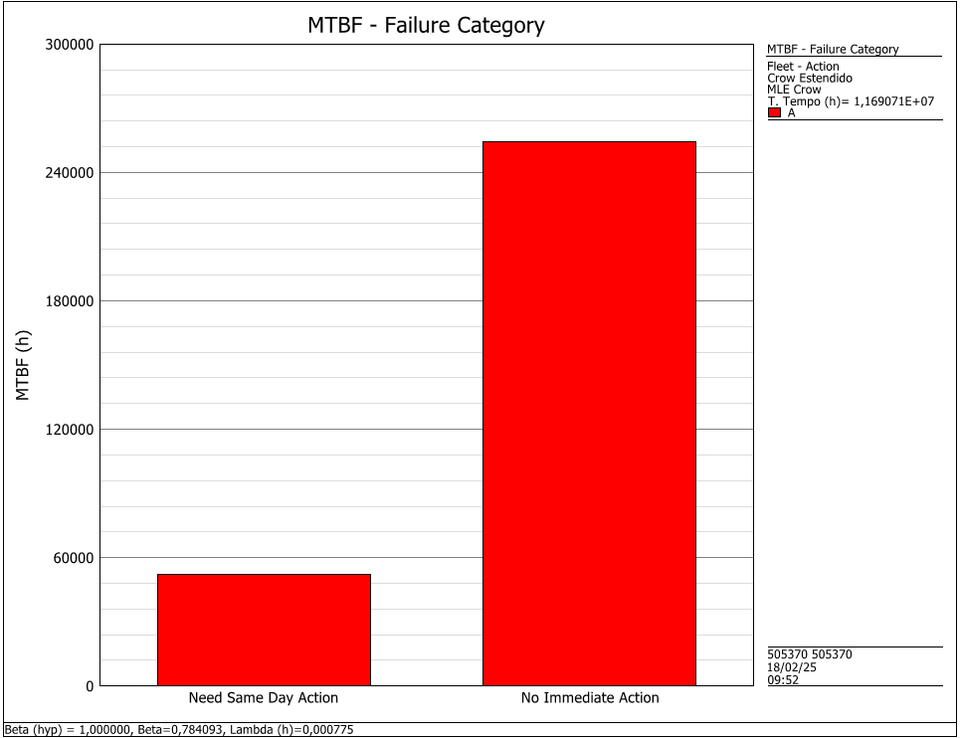
MTBF – Failure Category
Urgent – 52,191 hours
Non-urgent – 254,146

